Slide 1

CytoAutoCluster: A Semi-Supervised Approach to Cell Classification
By Gauthamkrishna N

Slide 2
Challenges in Cytometry
High-dimensional data is difficult to interpret.
Limited labeled data increases manual effort.
Noise affects clustering accuracy.
Solution:
CytoAutoCluster leverages semi-supervised learning to combine labeled and unlabeled data, improving accuracy while reducing reliance on annotations.

Slide 3
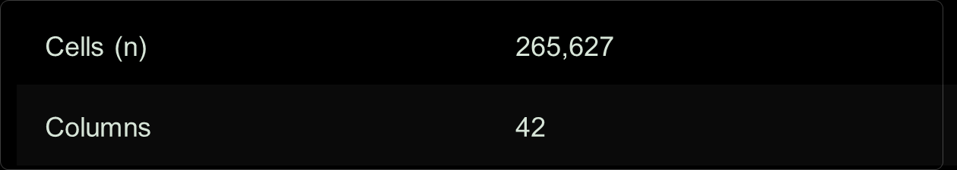
DATASET
Cytometry data with labeled and unlabeled samples.
Features include size, granularity, and protein expression.
Preprocessed to handle noise and missing values.

Slide 4
Methods
Semi-Supervised Learning: Combines supervised loss on labeled data with consistency regularization on unlabeled data.
Dimensionality Reduction:
PCA: Simplifies data by preserving variance.
t-SNE: Visualizes clusters in reduced dimensions.
Binary Masking: Introduces controlled noise to enhance model robustness.

Slide 5
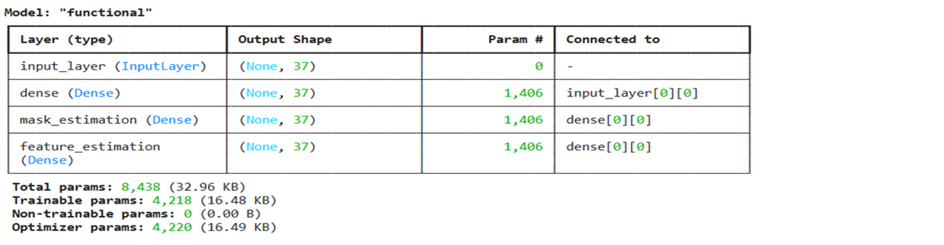
ENCODER
Role: Compresses high-dimensional data into latent features for clustering.
Architecture:
Two hidden layers followed by a latent space.
Trained to minimize reconstruction loss.
Benefits: Captures meaningful data patterns for downstream tasks.

Slide 6
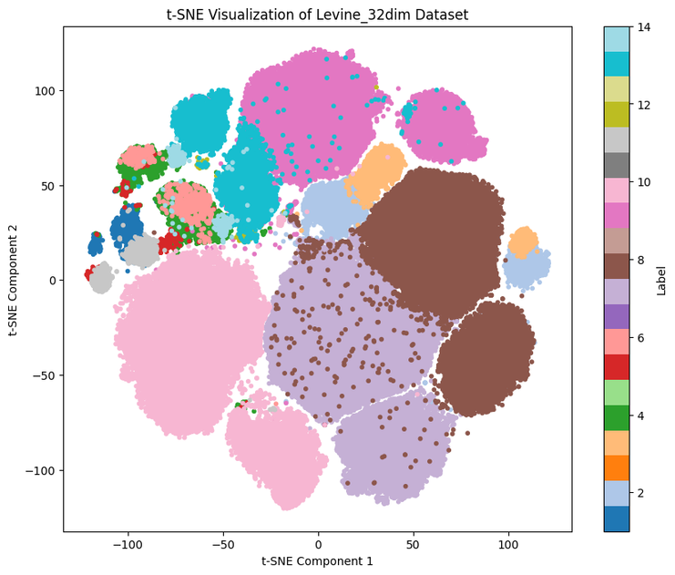
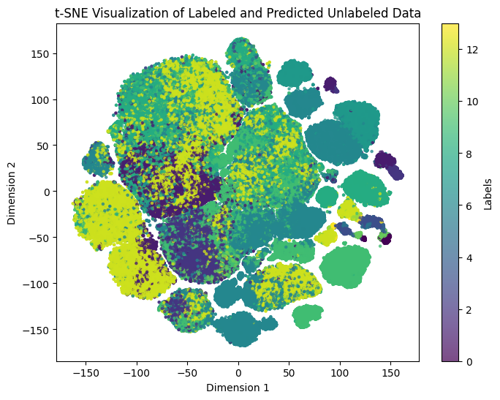
t-SNE
Purpose: Visualizes encoded data in 2D/3D to reveal clusters and local relationships.
Advantages:
Highlights distinct patterns in complex datasets.
Enhances interpretability for clustering results.

Slide 7

Evaluation Metrics
Accuracy: Measures prediction correctness.
AUROC: Assesses the model’s ability to distinguish between classes.
Silhouette Score: Evaluates the quality of clustering.

Slide 8
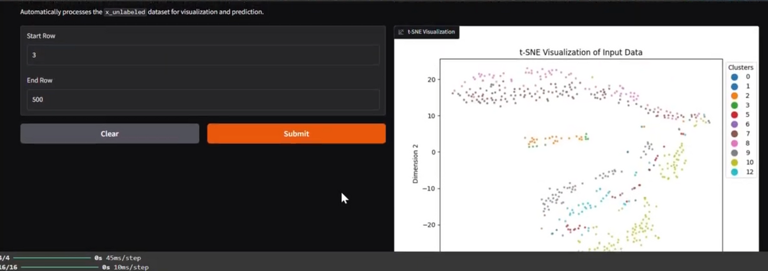
Results
Clustering Accuracy: Improved over traditional methods.
Rare Population Detection: Accurately identifies rare cell types.
Scalability: Efficiently handles large, noisy datasets.
Visualization: t-SNE and Gradio outputs for clear insights.

Slide 9
DEMOLINK

